Slide 1
Predicting Airline Profitability Using Machine Learning
A Data-Driven Approach to Optimize Airline Operations
Joshin Mathews joseph
Cds05_092

Slide 2
Introduction
Problem Statement Challenges in Airline Profitability:
Profitability depends on multiple operational & financial factors.
The goal is to predict profit (USD) per flight based on key variables.
Airline operators need a predictive model to optimize decision-making.

Slide 3
Data Overview Dataset Details:
Dataset: Aviation industry data
Key Features:
Operational Metrics: Flight delays, turnaround time, aircraft utilization
Financial Data: Revenue, operating costs, fuel efficiency
Maintenance & Availability: Fleet availability, downtime
Target Variable: Profit (USD)

Slide 4
Data Preprocessing Steps Taken:
Handling Missing Values
Numerical features filled with median values.
Categorical features filled with mode.
2.Feature Engineering:
Extracted hour, month, day of the week from time-related features.
Computed departure delay as a new feature.
3.Encoding Categorical Variables using Label Encoding.
4.Feature Scaling using StandardScaler for better model performance.

Slide 5
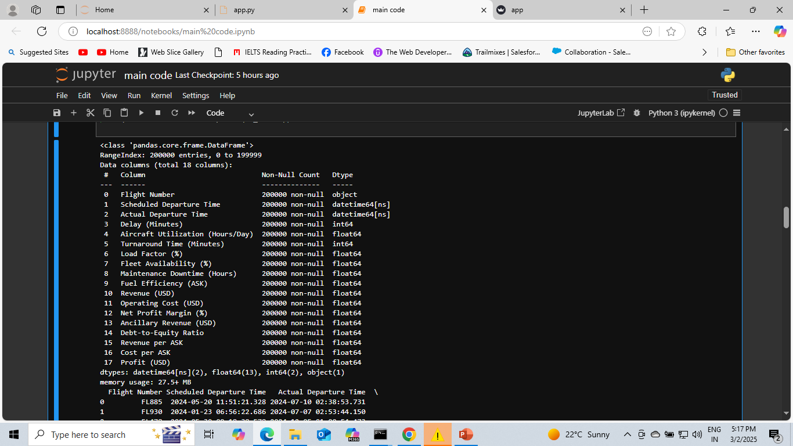

Slide 6
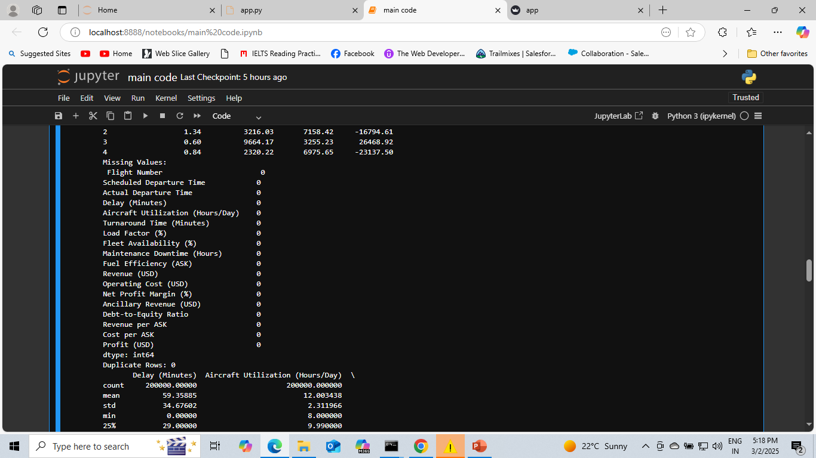

Slide 7
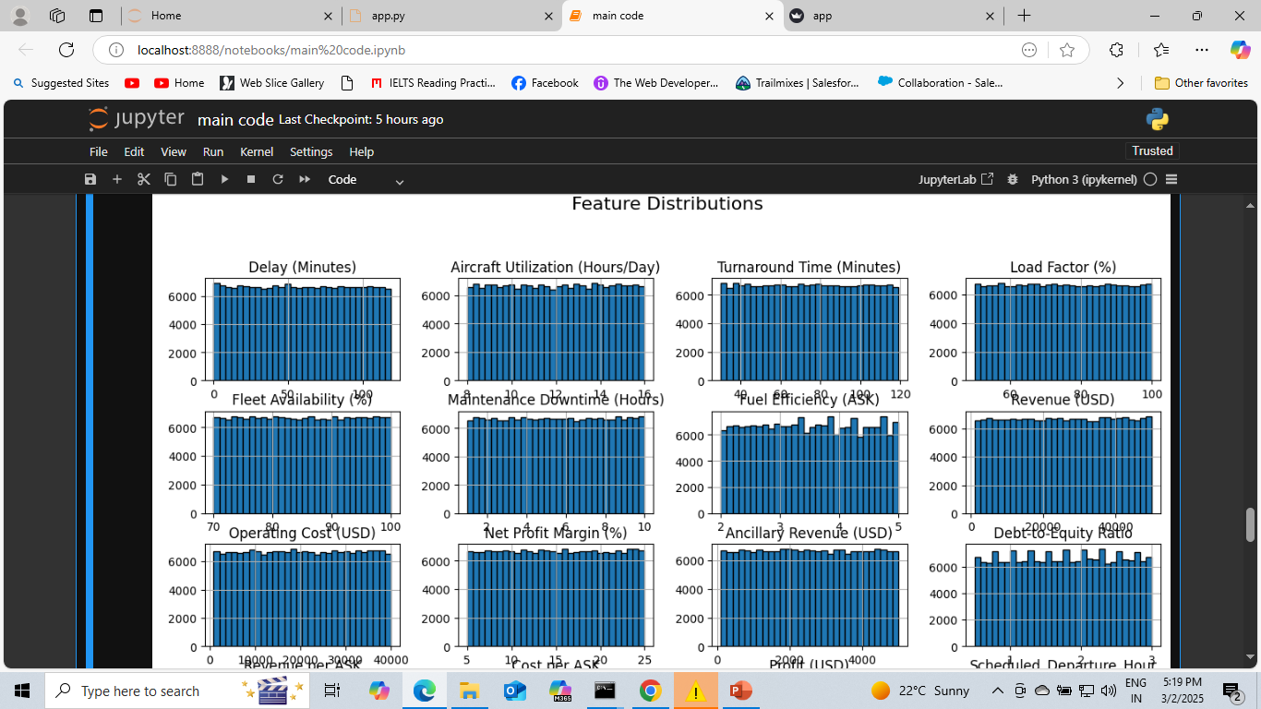

Slide 8
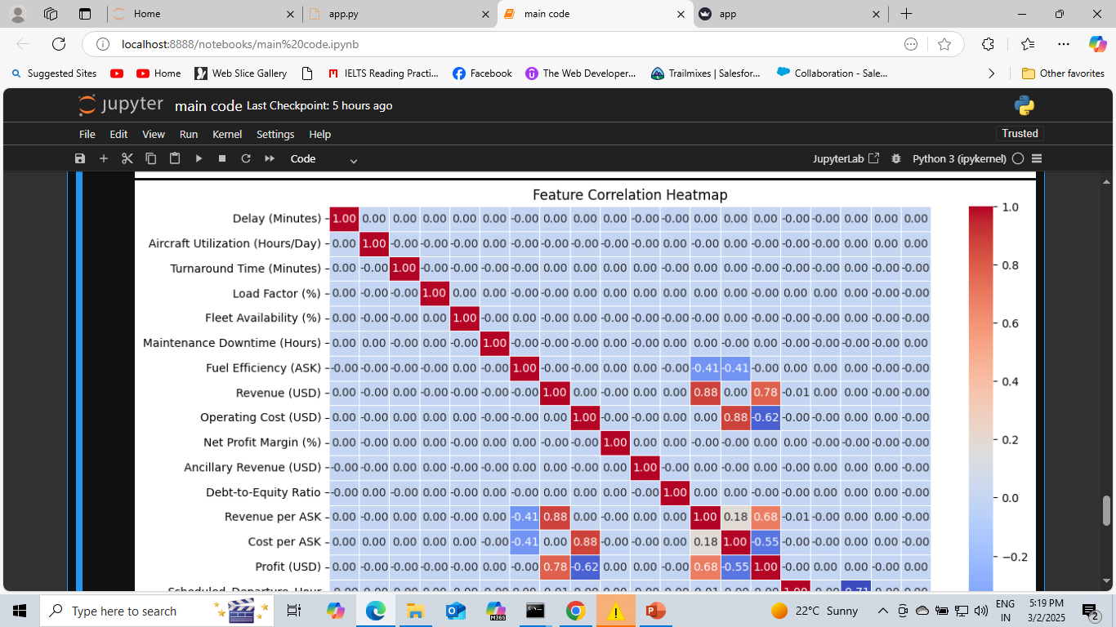

Slide 9
Exploratory Data Analysis (EDA) Insights from Data Analysis:
Profitability Trends: Identified key factors affecting profit.
Correlation Analysis: Found relationships between features and target variable.
Data Distributions: Visualized feature distributions using histograms and heatmaps.

Slide 10
Model Selection Chosen Model: Random Forest Regressor
Model Used: Random Forest Regressor
Why Random Forest?
Handles non-linearity well
Robust to outliers
Provides feature importance
Hyperparameters:
n_estimators=100

Slide 11
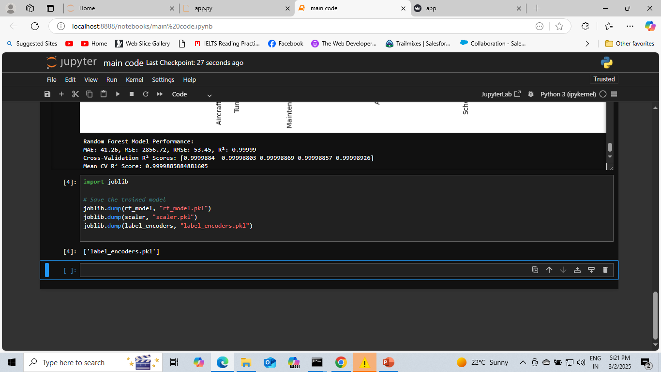
Model Training & Evaluation
Train-Test Split: 80% training, 20% testing
Performance Metrics:
Mean Absolute Error (MAE) = 41.26
Mean Squared Error (MSE) = 2856.72
Root Mean Squared Error (RMSE) = 53.45
R² Score = 0.99999 (high accuracy)
Cross-Validation R² Score: ~99.99% (consistent performance across folds)

Slide 12
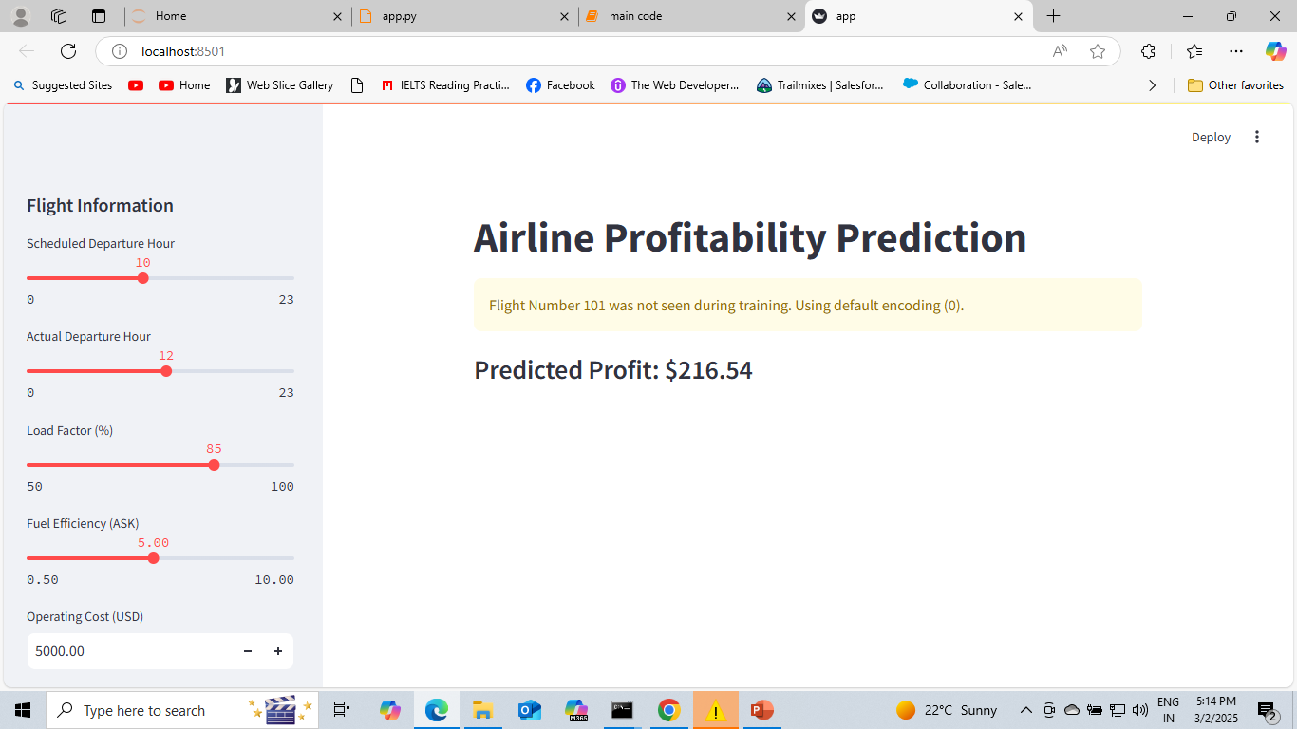
Deployment Strategy
Deployment Method: Streamlit
Steps:Trained & saved model (.pkl files)Created a Streamlit web app for user input & predictions

Slide 13
Challenges & Improvements
Challenges Faced:
Handling long execution times in cross-validation
Managing categorical variables efficiently
Future Enhancements:
Optimize feature selection
Experiment with XGBoost / LightGBM
Deploy on AWS / Google Cloud for scalability

Slide 14
Conclusion
Key Takeaways:
Random Forest effectively predicts airline profitability.
Operational efficiency directly impacts profits.
Deployment via Streamlit makes insights accessible.
Next Steps:
Experiment with additional models (XGBoost, LSTM for time series).
Optimize hyperparameters further.
Explore real-time prediction use cases.

Slide 15
Thank You!

